Slide 1
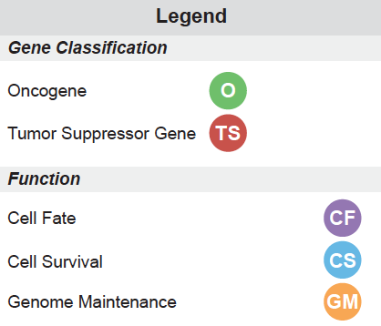
Cancer Genetics 5min overview
Yesterday’s groups (by cancer type) summary:
Cancer of the same type share common mutations
Today: Group according to patient number (1, 2, 3, 4)
What is similar between different cancers?
What is different?
Review answers to the “Cancer Genetics” worksheet

Slide 2
Lecture 3: Genetic Changes
Understand and be able to provide examples of how DNA mutations contribute to cancer
Understand and be able to provide examples of how aneuploidy contributes to cancer
Understand and be able to explain several different types of genomic lesions, the potential impact of each lesion on a proto-oncogene, and the consequences on DNA, RNA and protein levels for that oncogene.

Slide 3
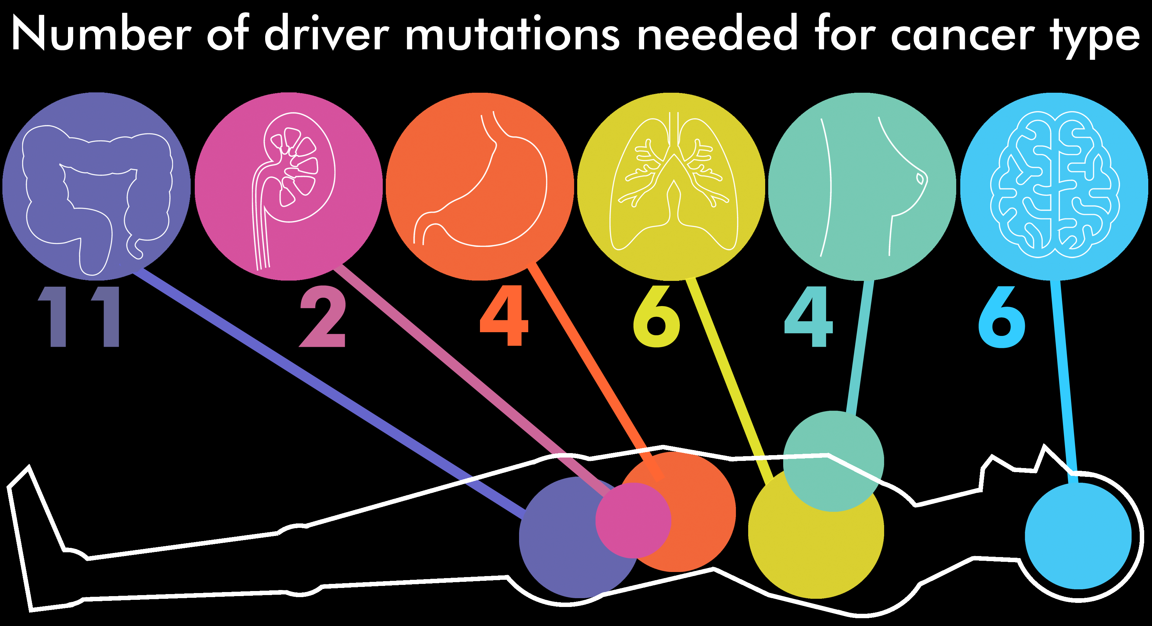
Cancer is a genetic disease
Most cancers are driven by 6-9 different gene mutations

Slide 4
Cancer genes are found throughout the genome
Are mutations in cancer genes the only mutations happening?
NO! Mutations are (mostly) random and also occurring in non-cancer genes
Carrier mutations and driver mutations may have the same underlying cause, but only driver mutations cause the cancer.

Slide 5
Cancer incidence increases with age
Why?

Slide 6
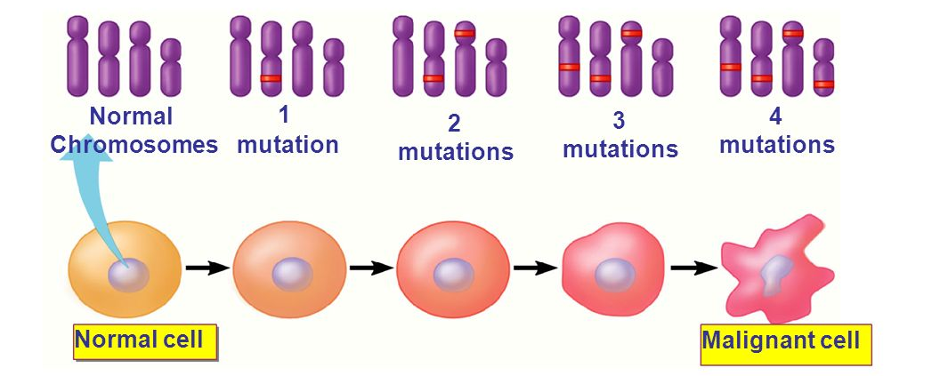
Cancer incidence increases with age
Cancer arises from the accumulation of genetic changes (mutations) over time
Combinations of mutations leads to transformation
Cells continue to acquire mutations as the cancer evolves → contributes to genetic heterogeneity in the tumor

Slide 7
Cancer Cell Evolution
Aneuploidy enables cancer cells to evolve resistance
to cancer therapies
Ongoing mutations:
Very heterogeneous in a few division cycles
→ Different (colored) cells have different mutations

Slide 8

Cancer Cell Evolution
Heterogeneity enables cancer cells to evolve resistance
to cancer therapies
+ Cancer therapy!
Ongoing mutations:
Very heterogeneous in a few division cycles
→ Different (colored) cells have different mutations
Chemotherapy kills most cancer cells
→ tumor shrinks!
Some cells evolve to be resistant to therapy
→ some cancer cells remain
Notes:
Now when the patient with this tumor is treated with chemotherapy drugs, because not all the cancer cells have the same genetic material, they may not all respond similarly to the cancer treatment. Some cells, by virtue of their different aneuploidy may have evolved to be resistant to therapy.

Slide 9
Cancer Cell Evolution
Heterogeneity enables cancer cells to evolve resistance
to cancer therapies
Ongoing mutations:
Very heterogeneous in a few division cycles
→ Different (colored) cells have different mutations
Chemotherapy kills most cancer cells
→ tumor shrinks!
Some cells evolve to be resistant to therapy
→ some cancer cells remain
→ tumor relapses & is drug resistant
Mutations both cause cancer and promote cancer evolution

Slide 10
Genetics of Cancer
Chromosomes are altered in most types of cancer cells
Changes in DNA sequence
Changes in chromosome number

Slide 11
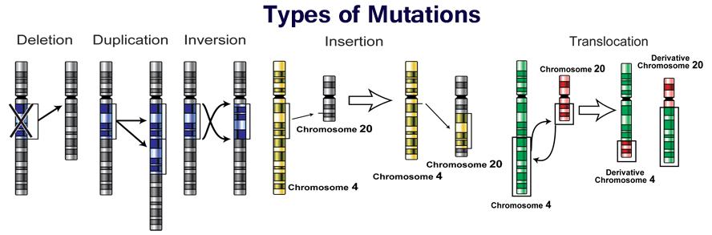
Mutations impact large areas of DNA
5 main types of large-scale genome mutations
Can impact single chromosomes
Can impact multiple chromosomes

Slide 12
How do these chromosome alterations happen?
Is there a common first step for all/most types of large-scale mutations?
Mutations in cancer result from an increase in DNA damage and/or a defect in damage repair
What could be the impact on genes at the boundaries of these mutations?
GROUP 3
GROUP 1
GROUP 2
GROUP 4
GROUP 5

Slide 13
Mutations can impact one or a few bases of DNA sequence
Mutations in a gene can disrupt the genetic code:
Normal Gene sequence: THE GAL SAW THE GUY EAT PIE
Point Mutation: THE GAL PAW THE GUY EAT PIE
Deletion: THE GAL THE GUY EAT PIE
Insertion: THE GAL SAW THE GUY EAT WPI E
Frame Shift: THE GAL SAW TGU YEA TPI E
DNA → mRNA → protein
Altered DNA = altered protein

Slide 14
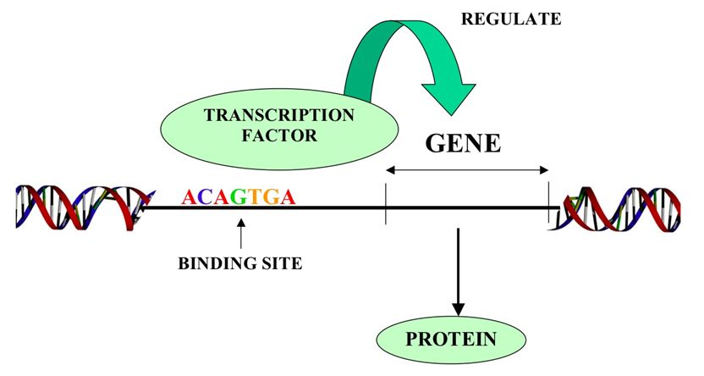
Mutations effect protein expression
Mutations near a gene can disrupt how it is regulated
Promoters, enhancers, transcription factors, etc bind to the DNA or mRNA with sequence specificity
Changes in the DNA sequence can alter how regulators bind and lead to changes in gene expression and protein production

Slide 15
single mutation, BIG impact
Proteins that are pleiotropic regulate other genes and can influence many cellular pathways
Transcription factors → regulate which mRNAs get made
Transcriptional regulators → regulate the transcription factors
Epigenetic regulators → regulate which genes are accessible to transcription factors
Mutation of a gene that encodes a pleiotropic factor will impact many pathways

Slide 16
pleiotropic factors in cancer
Ex: deletion mutation of a transcriptional or epigenetic regulator → loss of transcriptional regulation and massive de-regulation of it’s target genes
EX: Translocations can fuse two proteins → allow for new functions (gain of function) of the protein fusion
Could overexpression of a pleiotropic factor be a problem? How?
mRNA
TF
Epigenetic regulator
gene
TF
Gene
protein

Slide 17
Recap: cancer is a genetic disease
Cancer is driven by mutations in DNA
Mutations can impact:
large sections of one or more chromosomes
Single nucleotides
Are large deletions and amplifications always more impactful than single nucleotide changes?

Slide 18
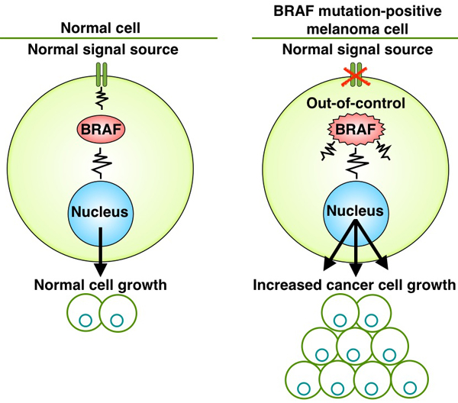
Recap: cancer is a genetic disease
EX:>60% of melanomas are driven my mutated BRAF (an oncogene)
The most common common activating mutation is caused by a single nucleotide change (T→A at position 1799)
This substitution changes the amino acid sequence of the protein the gene encodes
This single amino acid change increases the activity of mutant BRAF ~500-fold!
Bigger mutations are not necessarily more impactful

Slide 19
Genetics of Cancer
Chromosomes are altered in most types of cancer cells
Changes in DNA sequence
Changes in chromosome number

Slide 20
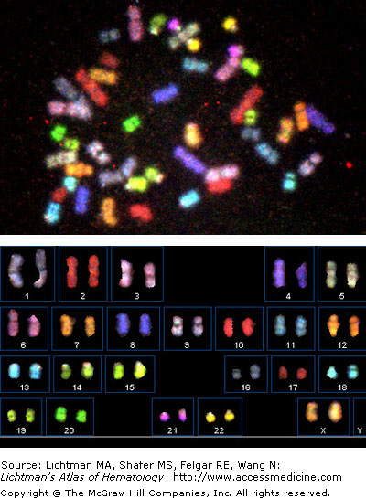
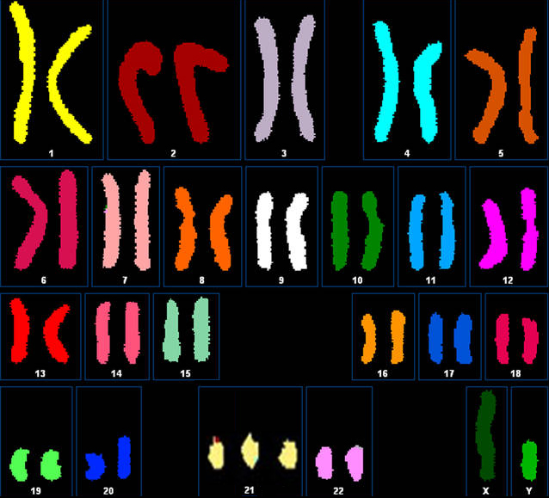
Abnormal chromosome numbers and human disease
Normal cell-Diploid
Aneuploid cell
Normal human cells have 23 pairs of chromosomes
Aneuploidy = an abnormal number of chromosomes
Aneuploidy is the leading cause of miscarriage and birth defects (most are aneuploidies are not viable)

Slide 21
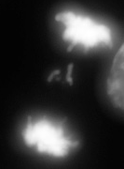
How is aneuploidy generated?
Anaphase cell with errors in chromosome segregation
How do cells gain or lose entire whole chromosomes?
Defects in mitosis (more in chapter 12)
What are the consequences of these gains and losses?
Are any chromosomes more likely to be lost than others?
Survival of the fittest

Slide 22
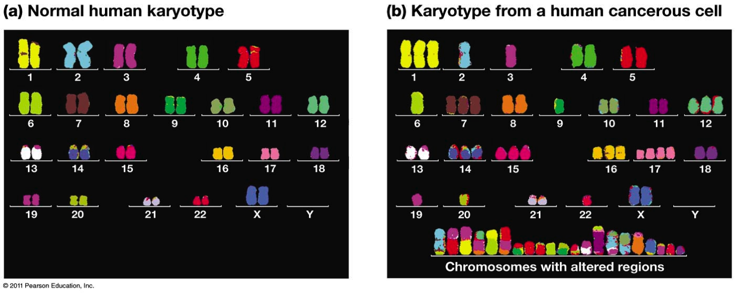
Aneuploidy is Common in Cancer
~90% of solid tumors are aneuploid
Most aneuploid cells persistently mis-segregate whole chromosomes → contributes to tumor heterogeneity and can CAUSE cancer
Why could this benefit the tumor?
Gains of oncogenes: KRAS is on Chromosome 12
Loss of tumor suppressors: CDKN2A is on Chromosome 9

Slide 23
Aneuploidy is Common in Cancer
Cancer cells can have BOTH mutations AND copy number changes
Cancers that are difficult to treat often have complex karyotypes

Slide 24
Somatic mutations cause proto-oncogene activation
Changes in the structure of encoded protein
Point mutations
translocations
Elevated, deregulated expression of encoded protein
Amplification
translocations

Slide 25
Oncogene activation
Group discussion
You are an oncologist and your patient has just been diagnosed with cancer. You know that the myc oncogene is commonly altered in this type of cancer, but before you can begin to define a therapeutic approach you need to confirm this and better understand the specific genomic lesions in this patient’s myc gene.
Use the whiteboard and describe how the following lesions may lead to activation of an oncogene (each has several possibilities)
Replication error
DNA double strand break
Whole chromosome segregation error
As a clinician or researcher, what would you look at to confirm this misregulation and/or rule out other possibilities

Slide 26
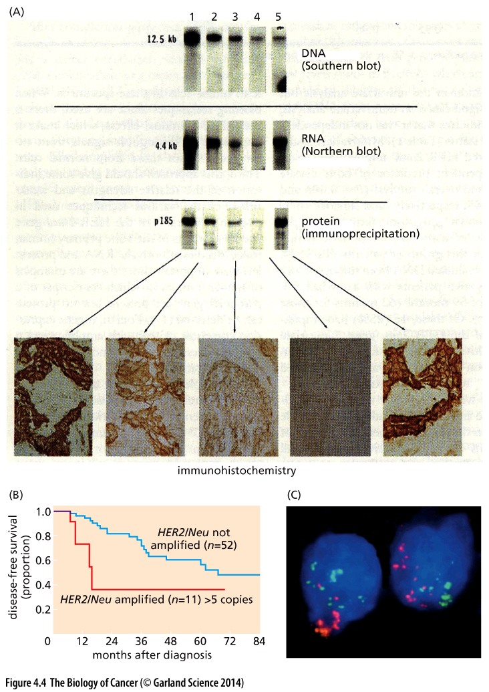
Increases in the HER2 oncogene promote breast cancer
How are increased oncogene levels achieved?
This figure shows HER2 protein is increased in tumors 1, 2, 3 and 5
DNA is increased in only tumor 1
What type of chromosomal change could account for increased HER2 in tumor 1?
Is there a different explanation for how protein levels of HER2 might become elevated in tumors 2, 3 & 5?
Mini discussion

Slide 27
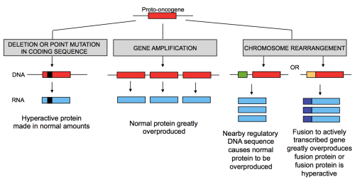
Varied ways to activate an oncogene
proto oncogenes can be activated by changes in gene number or expression…
Tumor 4 is also driven by HER2. How can this be?

Slide 28
Varied ways to activate an oncogene
proto oncogenes can be activated by changes in gene number or expression…
…or gene function
What tools do we have to analyze many genes or many patients at one?

